Slide 1

Database Architecture in Modern Web Applications
Understanding how databases serve as the backbone of web applications, managing data flow, security, and user interactions in sophisticated digital ecosystems.

Slide 2

The Critical Role of Database Systems
The database serves as the central nervous system of any modern website, orchestrating the storage, management, and organization of all critical data necessary for seamless operations. In our PostgreSQL-powered architecture, this translates to robust data persistence and reliable access patterns.
From user authentication credentials to dynamic content like news articles and educational materials, the database ensures that information remains accessible, secure, and consistently available across all user interactions and administrative operations.

Slide 3



Core Database Functions
Data Storage
Data Management
Access Control
PostgreSQL database stores user details, news articles, events, study materials, media files, and faculty information with complete data persistence.
CRUD operations enable admin users to create, read, update, and delete content through an intuitive dashboard interface.
Role-based authentication ensures only authorized users can modify content while maintaining secure data access patterns.

Slide 4





CRUD Operations in Action
Create
Admins upload new content including news articles, events, and study materials through the dashboard interface.
Read
Users and admins access stored data through optimized queries and API endpoints for seamless content delivery.
Update
Existing content can be modified and updated in real-time, ensuring information remains current and accurate.
Delete
Outdated or irrelevant content can be safely removed while maintaining data integrity and relationships.

Slide 5
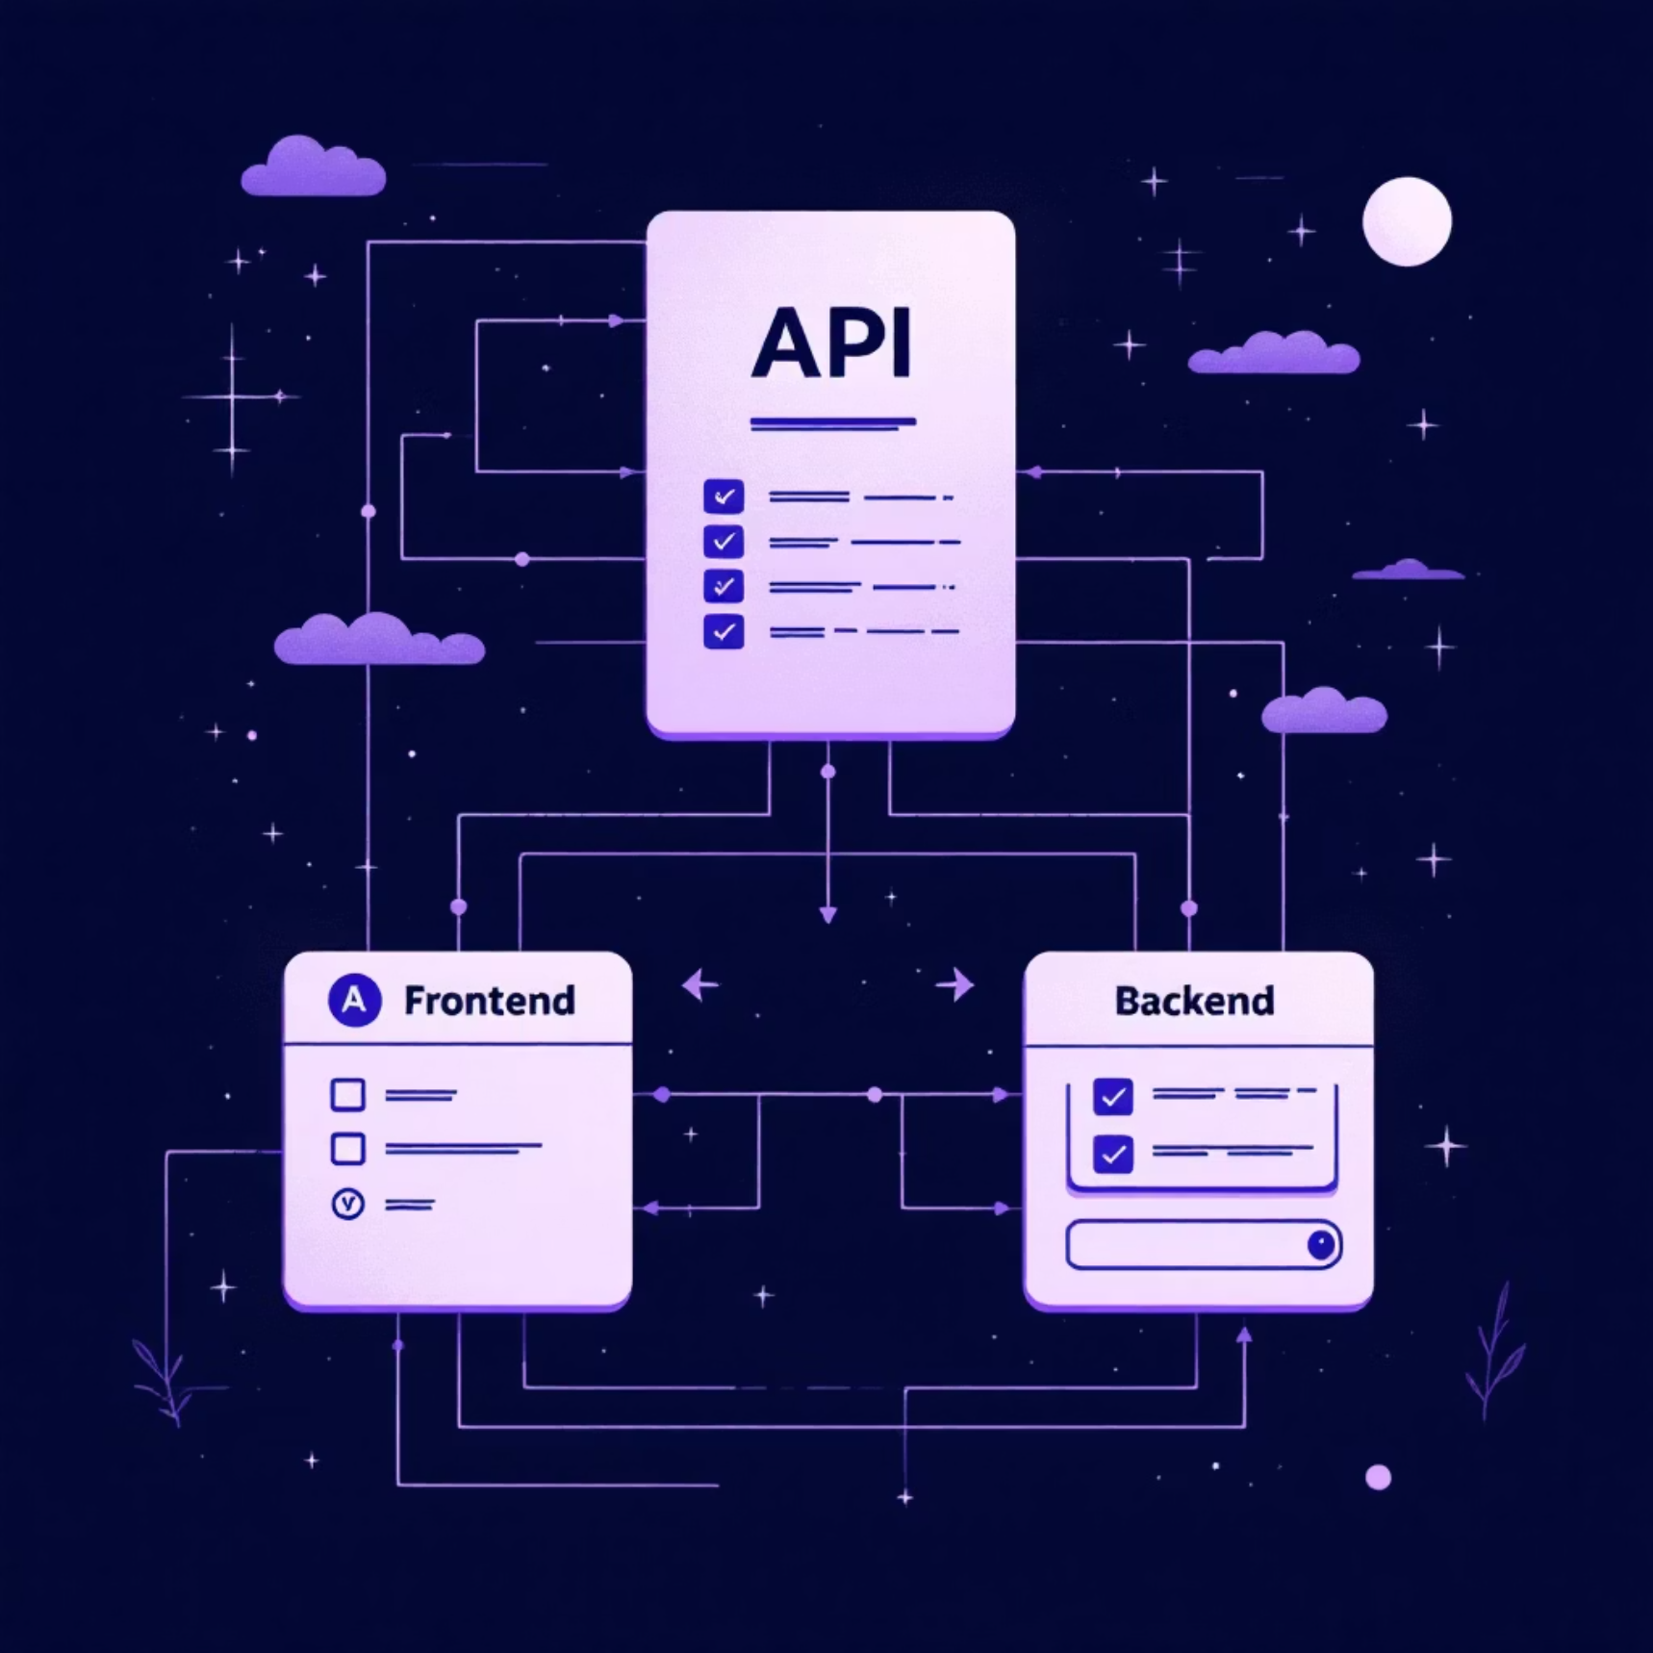
API Architecture & Data Flow
RESTful API Endpoints
The backend exposes comprehensive RESTful APIs that enable seamless communication between the React frontend and PostgreSQL database. These endpoints facilitate efficient data exchange and real-time updates.
/api/news - Latest news and announcements
/api/events - Upcoming workshops and seminars
/api/notes - Educational study materials
/api/media - Images and video content
Each API endpoint is designed for optimal performance, supporting both individual record retrieval and bulk operations for enhanced user experience.

Slide 6

Advanced Data Fetching Strategy
TanStack Query (React Query) revolutionizes how our application handles data fetching, providing sophisticated caching mechanisms and background updates that significantly enhance user experience.
01
02
Efficient Caching
Background Updates
Reduces unnecessary network requests by intelligently caching frequently accessed data and serving it instantly to users.
Automatically refreshes data in the background, ensuring users always see the most current content without manual refresh.
03
Optimistic Updates
Provides immediate feedback to users while data changes are processed, creating a responsive and fluid interface experience.

Slide 7






Database Schema & Relationships
The database architecture employs a carefully designed schema with interconnected tables that maintain data integrity through foreign key relationships and role-based access controls.
News
Notes
Articles linked to author and permissions
User notes with FK to items
Users
Events
Media
Accounts, roles, auth credentials
Event records tied to organizers
Files with ownership and access rules
This relational structure ensures that data remains consistent and accessible while maintaining security boundaries between different user roles and content types.

Slide 8

Authentication & Security Framework
JWT-Based Authentication
Our security architecture implements JSON Web Token (JWT) authentication to ensure robust access control and user verification across all system interactions.
Admin Access
Faculty Access
Full CRUD permissions for content management, user administration, and system configuration.
Limited content creation and modification rights for educational materials and announcements.
User Access
Read-only permissions for viewing content, downloading materials, and accessing public information.

Slide 9
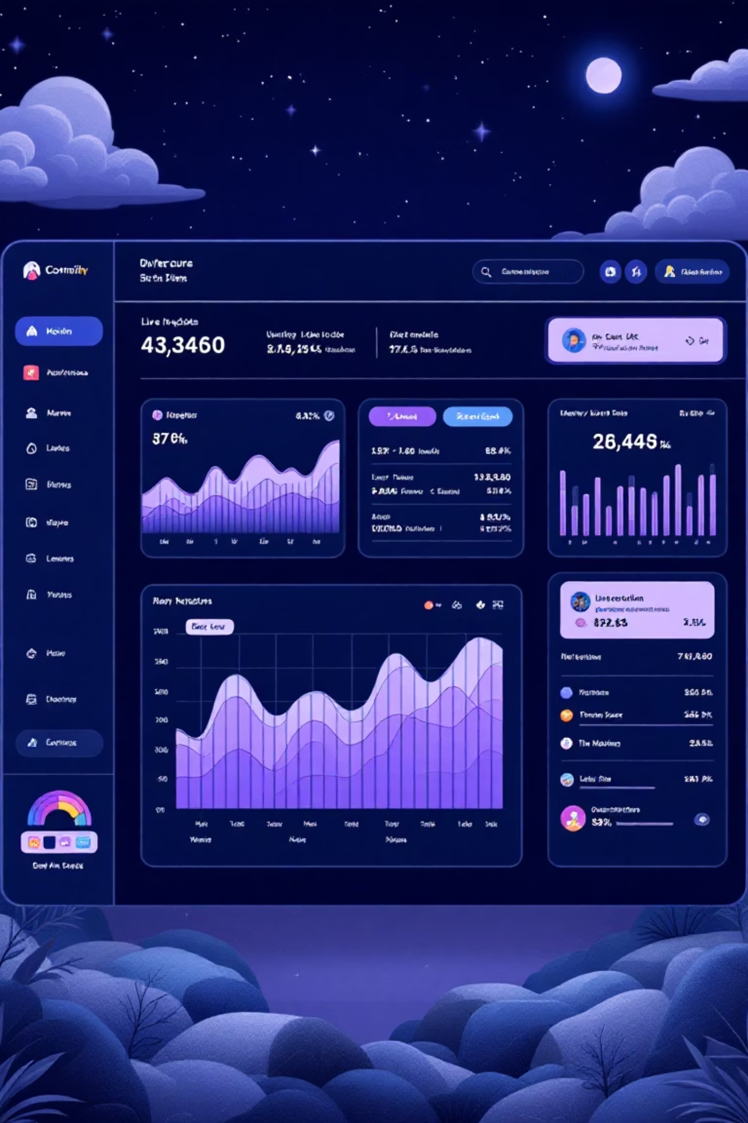
Real-Time Data Management
The database architecture supports dynamic, real-time content delivery for time-sensitive information like events, news updates, and announcements, ensuring users always have access to the latest information.
1
Data Creation
Admin creates new content through dashboard interface
2
Database Storage
Content is validated and stored in PostgreSQL with proper relationships
3
API Exposure
RESTful endpoints make data available for frontend consumption
4
User Access
Frontend fetches and displays updated content to end users

Slide 10



Technology Stack Integration
PostgreSQL
Robust relational database providing ACID compliance and advanced querying capabilities for complex data relationships.
Drizzle ORM
Type-safe database interactions in TypeScript environment, ensuring code reliability and developer productivity.
This integrated approach ensures that data flows seamlessly from storage through APIs to user interfaces, creating a cohesive and efficient web application architecture that scales with organizational needs.
"The database serves as the foundation upon which all user interactions, content management, and security protocols are built, ensuring reliable and secure access to information across all user roles and system functions."

